Slide 1
305.3 - Applying Data Access Object and
Object-Oriented Programming to Java Database Connectivity

Slide 2
Applying Data Access Object and
Object-Oriented Programming to Java Database Connectivity Project
‹#›
Learning Objectives:
In this presentation, you will explore the Data Access Object (DAO) pattern, and apply the Object-Oriented Programming (OOP) concept and DAO pattern in JDBC application.
By the end of this lesson, learners will be able to:
Describe the Design pattern and DAO Design pattern.
Demonstrate the DAO pattern.
Demonstrate how to apply the OOP concept and DAO pattern in JDBC application.

Slide 3
Table of Contents
Overview of Design Pattern.
Usage of Design Pattern.
Data Access Object Patterns.
Data Access Object Pattern Components
Applying OOP and Data Access Object to JDBC Application.
Before Data Access Object - Process of Java JDBC API.
After Data Access Object - Process of Java JDBC API .

Slide 4
Overview of Design Pattern

Slide 5
Overview of Design Pattern
Authors, Erich Gamma, Richard Helm, Ralph Johnson and John Vlissides published a book titled Design Patterns - Elements of Reusable Object-Oriented Software (1994), which initiated the concept of Design Patterns in Software development. The authors are collectively known as Gang of Four (GOF), and according to them, design patterns are primarily based on the following principles of object-oriented design (OOD):
Program to an interface, not an implementation.
Favor object composition over inheritance.
The software/application design pattern is a general, reusable solution to a commonly occurring problem within a given context in software design. It is not a finished design that can be transformed directly into source or machine code. It is a description or template for how to solve a problem that can be used in many different situations.
Design patterns are best practices that programmers can employ to overcome common design difficulties, and are solutions to general problems that software developers faced during software and application development. These solutions were obtained by trial and error by numerous software developers over a substantial period of time.

Slide 6
Usage of Design Pattern
Design Patterns have two main uses in software development:
Common platform for developers.
Design patterns provide standard terminology, and are specific to a particular scenario. For example, a Singleton design pattern signifies use of a single object so that all developers familiar with a single design pattern will make use of a single object, and can verify that the program is following a single pattern.
Best Practices for developers.
Design patterns have evolved over a long period of time, and they provide best solutions to certain problems faced during software development. Learning these patterns helps inexperienced developers learn software design in a fast and easy way.

Slide 7

Data Access Object Patterns
Introduction :–
Data Access Object (DAO) is a pattern that provides an abstract interface to some type of database or other persistence mechanism.
DAO Design Pattern is used to separate the data persistence logic into a separate layers. This way, the service remains completely in the dark about how the low-level operations access the database. This is known as the principle of Separation of Logic.
DAO is used to separate low-level data accessing API (like JDBC) or operations from high-level business services or the idea is to abstract or hide the database logic from the business layer.
img src: medium.com
Click here for more information about DAO.

Slide 8
Data Access Object Patterns (continued)
The advantage of using data access objects is the relatively simple and rigorous separation between two important parts of an application that do, but should not know of each other, and which can be expected to evolve frequently and independently.
If we need to change the underlying persistence mechanism, we only have to change the DAO layer, and not all the places in the domain logic where the DAO layer is used.

Slide 9
Data Access Object Pattern Components
DAO - Data Access Object Interfaces - This interface defines the standard operations performed on the model object(s). The interfaces provide a flexible design.
DAO - Data Access Object classes - This class implements above the interface, and is responsible for getting data from a data source, which can be a database / xml or any other storage mechanism. The interface implementation is a concrete implementation of the persistence logic.
DAL - Data-Access Layer - DAL is made up of interface and implementation classes for DAO. This layer provides easy and simplified access to data stored in persistent storage, such as an entity-relational database or any database, in applications. This layer is between the Service Layer and the storage layer.
Model Classes / DTO - This object is simple POJO class containing getter and setter methods to store data retrieved using DAO class.
DataSource: A data source could be a database such as an RDBMS, File,, XML repository, flat file system, or any other data source. A data source can also be another system service or some kind of repository.

Slide 10
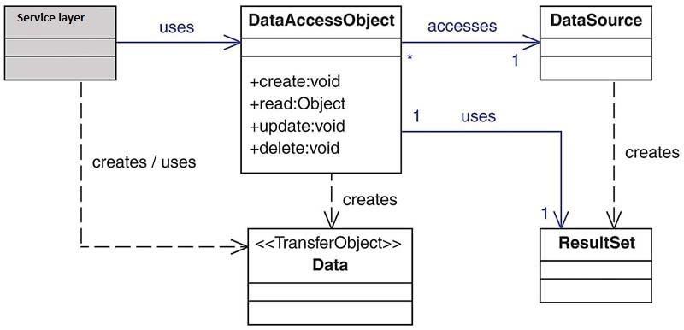
Data Access Object Pattern Components (continued)
High-level Class Diagram representing the relationships for the DAO Pattern.
Img Source: Per Scholas. 2022
Notes:
Data transfer object(DTO), if multiple requests are required to bring data for a particular task, data to be brought can be combined in a DTO so that only one request can bring all the required data.

Slide 11
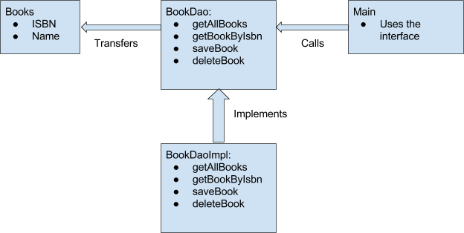
Implementing the Data Access Object - Example 1
Let's use Books as an example. With DAO design pattern, we have the following components on which our design depends:
The Model class or the transfer object, which is transferred from one layer to the other.
The interfaces, which provide a flexible design.
The interface implementation, which is a concrete implementation of the persistence logic.
We will use four components here:
The Book model class, which is transferred from one layer to the other.
The BookDao interface that provides a flexible design and API to implement.
The BookDaoImpl class, which is an implementation of the BookDao interface.
The main() method, which is the entrypoint of the application.
img Source:digitalocean.com
Notes:
DAO - Data Access Object Pattern

Slide 12
Implementing the Data Access Object Pattern - Example 1
Books.java class
Step 1: Create a new project and add a JDBC driver in the project. Then create a package named model under src folder.
Step 2: Under model package, create a class named Books. Write the code on the right in class.
This will be our model class. To keep things simple, it has a simple object with just two properties.
package model;
public class Books {
private int isbn;
private String bookName;
public Books() { }
public Books(int isbn, String bookName) {
this.isbn = isbn;
this.bookName = bookName;
}
// getter setter methods
public int getIsbn() {
return isbn;
}
public void setIsbn(int isbn) {
this.isbn = isbn;
}
public String getBookName() {
return bookName;
}
public void setBookName(String bookName) {
this.bookName = bookName;
}
}
(continued)

Slide 13
Implementing the Data Access Object Pattern - Example 1
(continued)
BookDao.java interface
Step 3: Create a package named DAOinterface under src folder.
Step 4: Under DAOinterface package, create an interface named BookDao. Write the code on the right in the class.
import java.util.List;
import model.Books;
public interface BookDao {
List<Books> getAllBooks();
Books getBookByIsbn(int isbn);
void saveBook(Books book);
void deleteBook(Books book);
}

Slide 14
Implementing the Data Access Object Pattern - Example 1
Step 5: Create a package named Controller under the src folder.
Step 6: Under Controller package, create a class named BookDaoImpl. Add write the code on the right in the class.
Finally, here is how we use our DAO to manage Books:
BookDaoImplclass supports getallbooks, save(insert), update, and delete operations. We can add more operations in future if needed. The business layer remains unaware of the actual persistence logic.
In this class, just for the sake of simplicity, we have used an ArrayList as a data store instead of interacting with some DB. In a real-world situation, we will interact with some database.
(continued)
BookDaoImpl.java class
import java.util.ArrayList;
import java.util.List;
import DAOinterface.BookDao;
import model.Books;
public class BookDaoImpl implements BookDao {
//list is working as a database
private ArrayList<Books> booksObj;
public BookDaoImpl() {
booksObj = new ArrayList<Books>();
booksObj.add(new Books(1, "Java Book"));
booksObj.add(new Books(2, "Python Book"));
booksObj.add(new Books(3, "Android Book"));
}
@Override
public List<Books> getAllBooks() {
return this.booksObj;
}
@Override
public Books getBookByIsbn(int isbn) {
return this.booksObj.get(isbn);
}
@Override
public void saveBook(Books book) {
this.booksObj.add(book);
}
@Override
public void deleteBook(Books book) {
this.booksObj.remove(book);
}
}

Slide 15
Implementing the Data Access Object Pattern - Example 1
Step 7: Create a package named Runner under the src folder.
Step 8: Under Runner package, create a class named AccessBook. This class contains main() method.
Write a code in class, available on the right side. Run this class.
import Controller.BookDaoImpl;
import DAOinterface.BookDao;
import model.Books;
import javaa.awt.print.Book;
import java.util.ArrayList;
public class AccessBook {
public static void main(String[] args) {
System.out.println( "############# show list of all books ########## ");
BookDao bookDao = new BookDaoImpl();
for (Books b : bookDao.getAllBooks()) {
System.out.println("Book ISBN : " + b.getIsbn() +" and Book Name : " + b.getBookName() );
}
System.out.println("--------- After added/ inserted new book ----------");
Books b1 = new Books();
b1.setIsbn(4);
b1.setBookName("SQL Book");
bookDao.saveBook(b1);
for (Books b : bookDao.getAllBooks()) {
System.out.println("Book ISBN : " + b.getIsbn() +" and Book Name : " + b.getBookName() );
}
System.out.println("--------- After update book name ----------");
Books bookupdate = bookDao.getAllBooks().get(1);
bookupdate.setBookName("Algorithms Book");
for (Books b : bookDao.getAllBooks()) {
System.out.println("Book ISBN : " + b.getIsbn() +" and Book Name : " + b.getBookName() );
}
}
}
Output
############# show list of all books ##########
Book ISBN : 1 and Book Name : Java Book
Book ISBN : 2 and Book Name : Python Book
Book ISBN : 3 and Book Name : Android Book
------After added/ inserted new book ----------
Book ISBN : 1 and Book Name : Java Book
Book ISBN : 2 and Book Name : Python Book
Book ISBN : 3 and Book Name : Android Book
Book ISBN : 4 and Book Name : SQL Book
--------- After update book name ----------
Book ISBN : 1 and Book Name : Java Book
Book ISBN : 2 and Book Name : Algorithms Book
Book ISBN : 3 and Book Name : Android Book
Book ISBN : 4 and Book Name : SQL Book
Notes:
As we work with interfaces in DAO pattern, it also emphasizes the style of “work with interfaces instead of implementation” which is an excellent OOPs style of programming.
As the persistence logic is completely separate, it is much easier to write Unit tests for individual components. For example, if you’re using JUnit and Mockito for testing frameworks, it will be easy to mock the individual components of your application.

Slide 16
Applying OOP and DAO to JDBC Application
We will now explore how to use DAO.

Slide 17
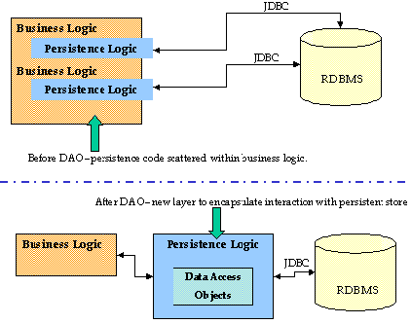
Before Data Access Object - Process of Java JDBC API
Let’s use the DAO pattern in a simple JDBC CRUD application.
Register the Driver - Same every time / Repeat.
Connect to the Database - Same every time / Repeat.
Prepare the Statement.
Execute the Statement.
Obtain data from the Database.
Close the connection - Same every time / Repeat.
Before DAO, persistence code scattered within business logic.

Slide 18
After Data Access Object - Process of Java JDBC API
The New Process for JDBC Application with DAO
Start with AbstractDAO
Registers Driver.
Connects to Database.
Safely closes connection.
Create Interface for each DAO
Contains queries.
Structure for methods(CRUD).
Implement DAO
Write logic for interface methods.
Start with register/connect method.
End with close method.
Use business logic anywhere in the application.
Before DAO, persistence code scattered within business logic.
After DAO, new layer to encapsulate interaction with persistent.
Image Source: oracle.com

Slide 19
Example: After Data Access Object - Process of Java JDBC API
Let’s take the same example of books. There are several ways to implement DAO and OOPs in our JDBC application. We are trying to illustrate it in a simple way. Below is a class level diagram for how to implement the DAO, OOP concept and JDBC in application.
Interface / Data Access object
Implements
DAOfactory
BookDao interface
package: Dao
ConnectionDAO class
package: Dao
uses / establish connection
CRUD operations
createBooks();
readBooks();
updateBooks();
deleteBooks();
MySQLConnection();
OracleConnection();
PostgresConnection();
ODBCConnection();
Business / Controller Layer
BooksDaoImpl class: interface Implementation
package: Controller
Create Business logic
createBooks(){ ..}
readBooks() {...}
updateBooks(){...}
deleteBooks(){...}
uses / caller
uses
transfer / populates
Service Layer / Invoker / User
Model / Data Transfer Object
AccessBook class
package: Runner
Books class
package: model
main()
Microservices
WebServices
Class variables
Constructors
Getter / setters
Oracle Database
MySQL Database
Illustration of the complete project
Per Scholas. 2022

Slide 20
Hands-On Lab: After DAO - Process of Java JDBC API
Find the GLAB 305.3.1- Building Java CRUD application using DAO pattern, OOP concept, and JDBC on Canvas under the Guided Labs section.

Slide 21
Practice Assignment
Create Table in Database:
Customer table:
id(int), email(varchar), fname(varchar), lname(varchar)
Item table:
id(int), name(varchar), price(decimal(4,2)).
Create models for each table.
Create DAOs with the following methods:
CustomerDAO
getCustomerById(int id) - Returns the customer object for the given id.
addCustomer(Customer c) - Adds a customer with given information.
removeCustomerById(int id) - Removes a customer with the given id.
ItemDAO
getAllItems() - Returns a list of all item objects in the database.
addItem(Item i) - Adds an item with given information.
removeItemById(int id) - Removes an item with the given id.
Create additional classes and attributes.

Slide 22
Knowledge Check
What is Design Pattern and why do we use it?
What is the Data Access Object (DAO) Pattern.
What are the Data Access Object Pattern components.

Slide 23
Summary
The Data Access Object (DAO) Pattern is now a widely accepted mechanism to abstract away the details of persistence in an application. The idea is that instead of having the domain logic, communicate directly with the database, file system, web service, or whatever persistence mechanism your application uses. The domain logic speaks to a DAO layer instead.
Every module (or group of routes example: /auth/<signup, login,etc.>) should have its own DAO layer.
Every module (or group of routes example: /auth/<signup, login,etc.>) should have its own set of models.
The DAO layer should use database queries as much as possible for various data manipulations.
Models should have their own getter and setter functions, which should be used by the Controller/DAO for data updation and retrieval.

Slide 24
Glossary/Terminology
DAO: Data Access Object
DTO: Data Transfer Object
DAL: Data: Access Layer
BLL: Business/controller Logic Layer
POJO: Plain Old Java Object
CRUD: Create, Read/Retrieve, Update and Delete
GOF: Gang of Four

Slide 25
References
http://www.oracle.com/techn
https://en.wikipedia.org/wiki/Data_access_objectetwork/java/dataaccessobject-138824.html
https://en.wikipedia.org/wiki/Data_access_object
https://www.linkedin.com/pulse/data-access-object-dao-design-pattern-java-mohammed/

Slide 26

Questions?
‹#›
Notes:
This slide is meant to address any questions students had from reviewing the UPCOMING slides, having reviewed them the PREVIOUS NIGHT.
DO NOT answer the questions at this time, just make a mental note of them, knowing that those slides may take longer.
Hopefully, however, without questions from the review, all other slides can proceed quickly.

